Slide 2
Plintron GTACT Portal

Slide 3
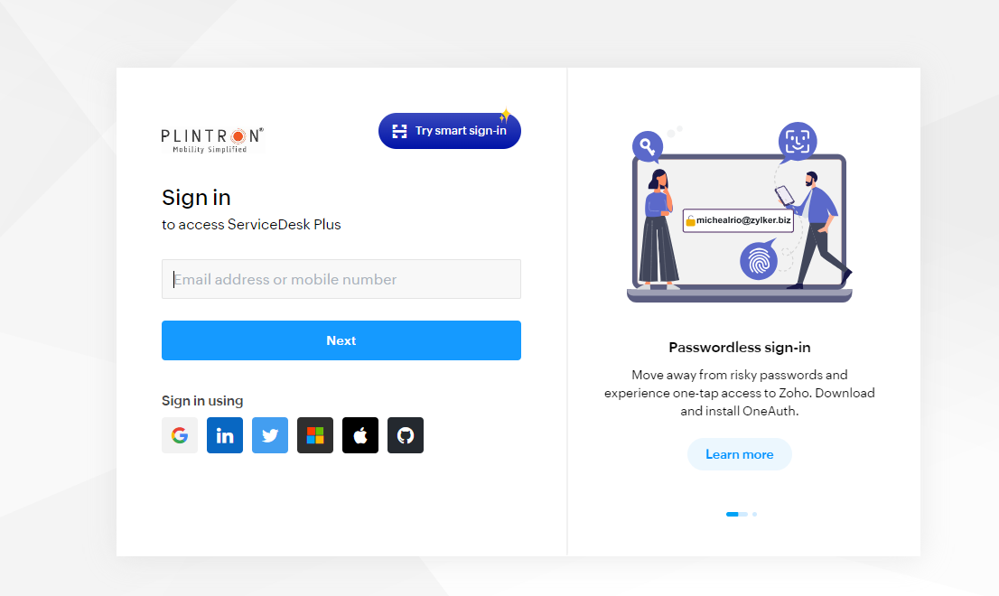
Login Page
Plintron Portal is used to raise the Ticket with Plintron/BSNL team for ESIM dual profile cases

Slide 4
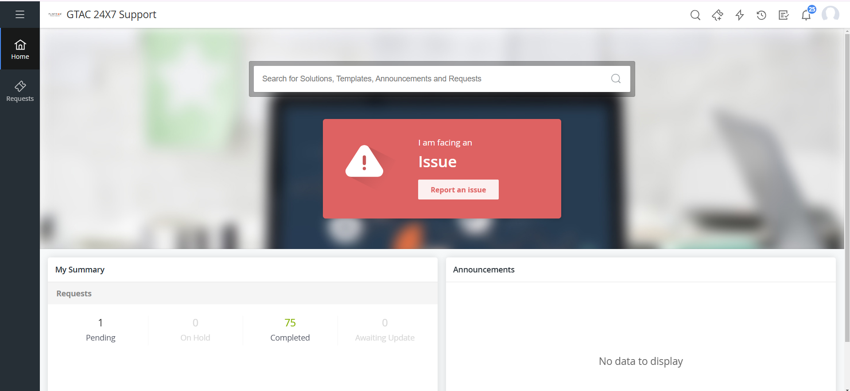
Home Page
Click on I am facing an Issue- Report Issue

Slide 5
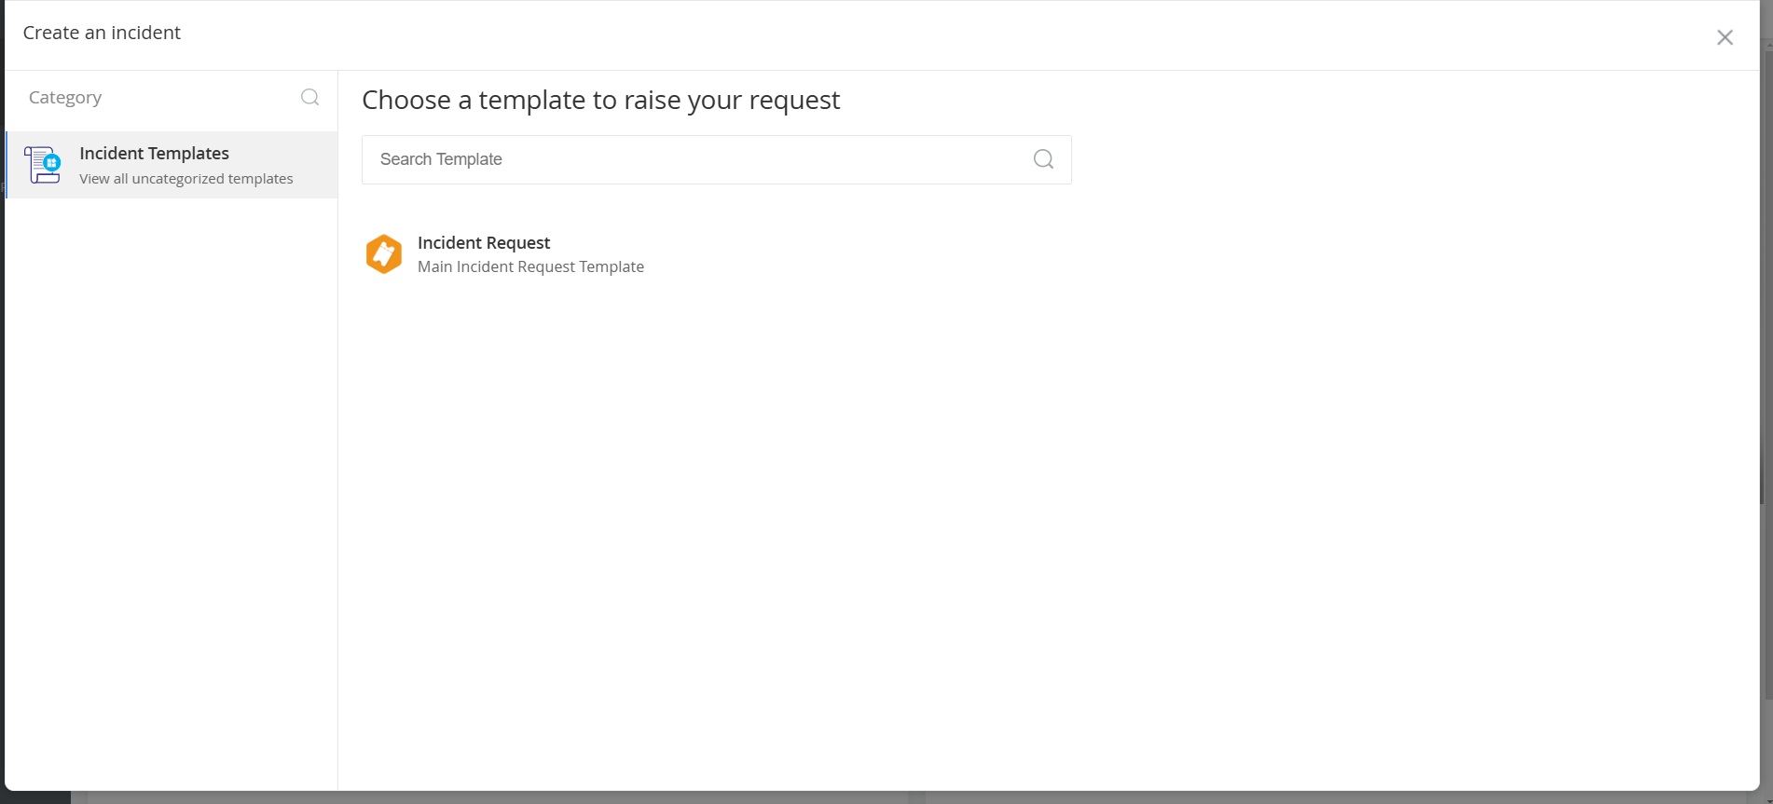
Incident Management

Slide 6
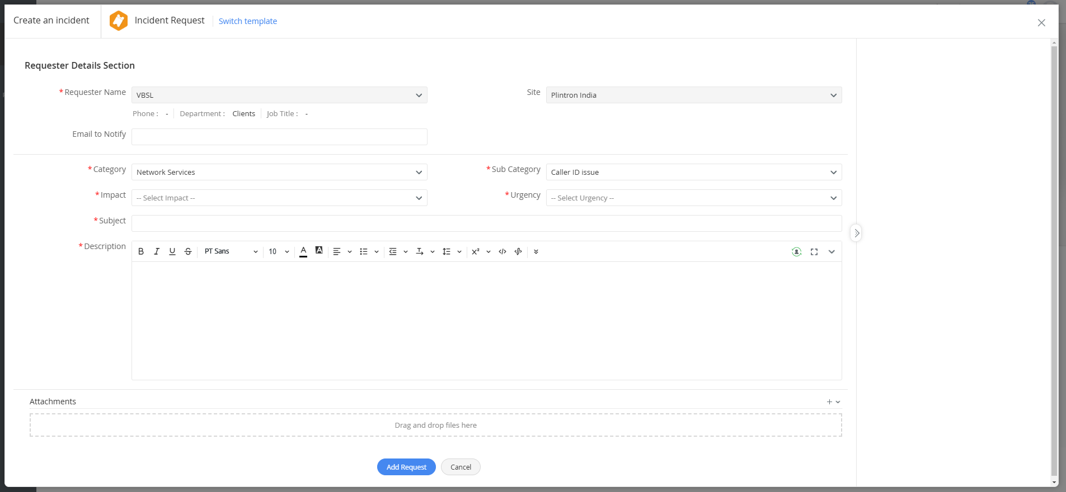
Ticket Booking Interface

Slide 7
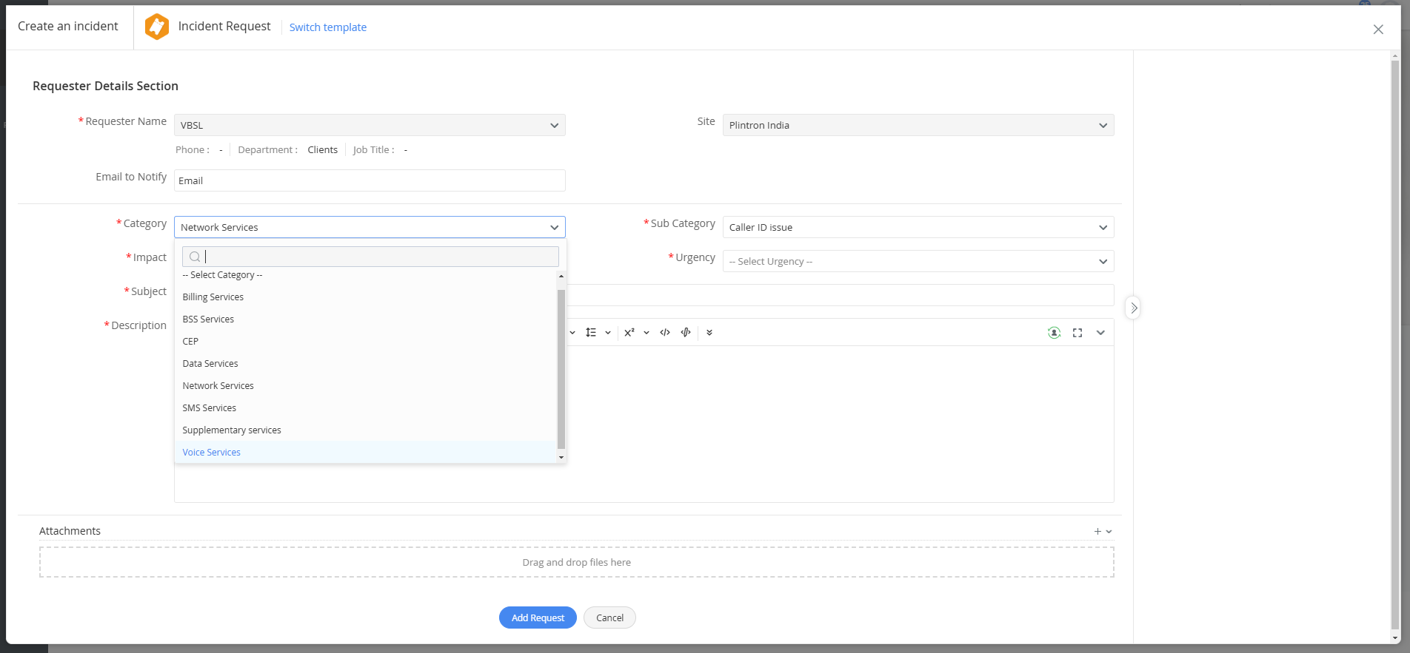
Selecting the Category- Data services

Slide 8
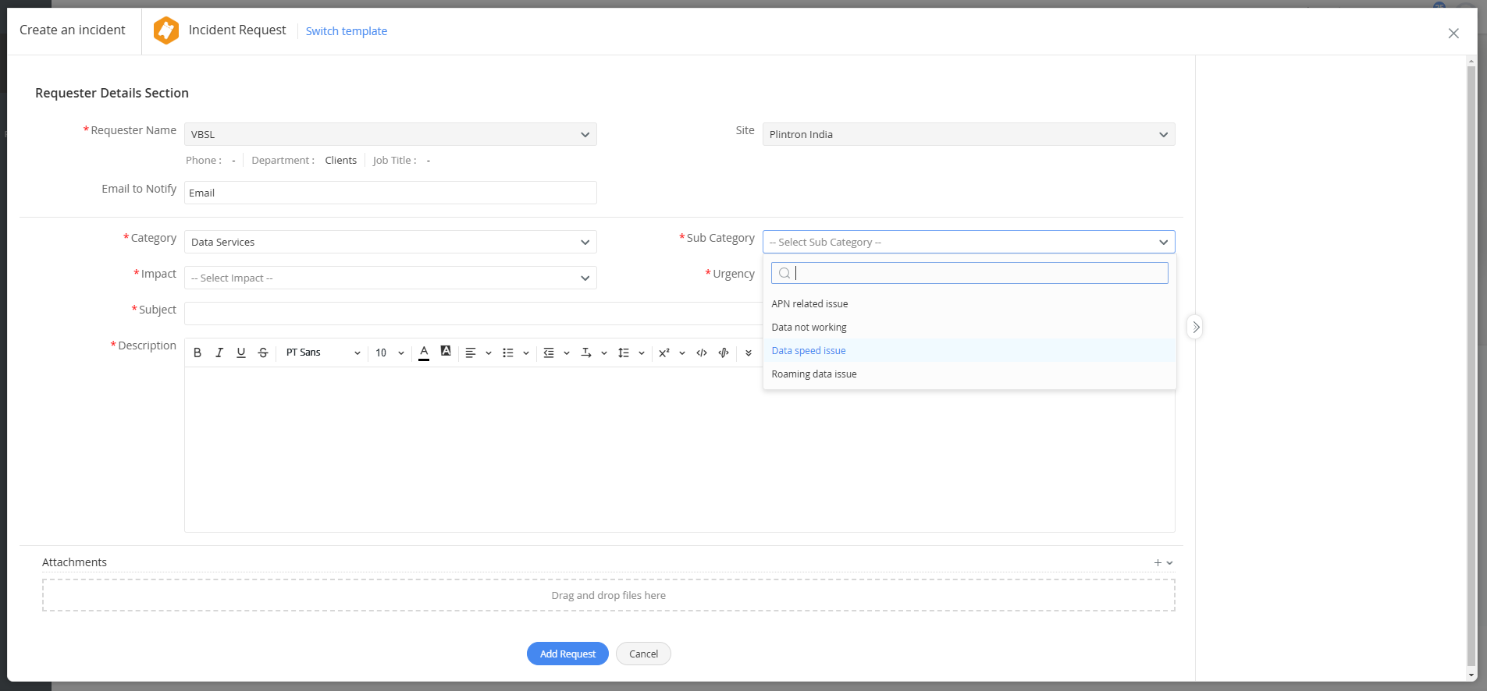
Selecting the Sub Category- Data not working/ Data Speed issue

Slide 9
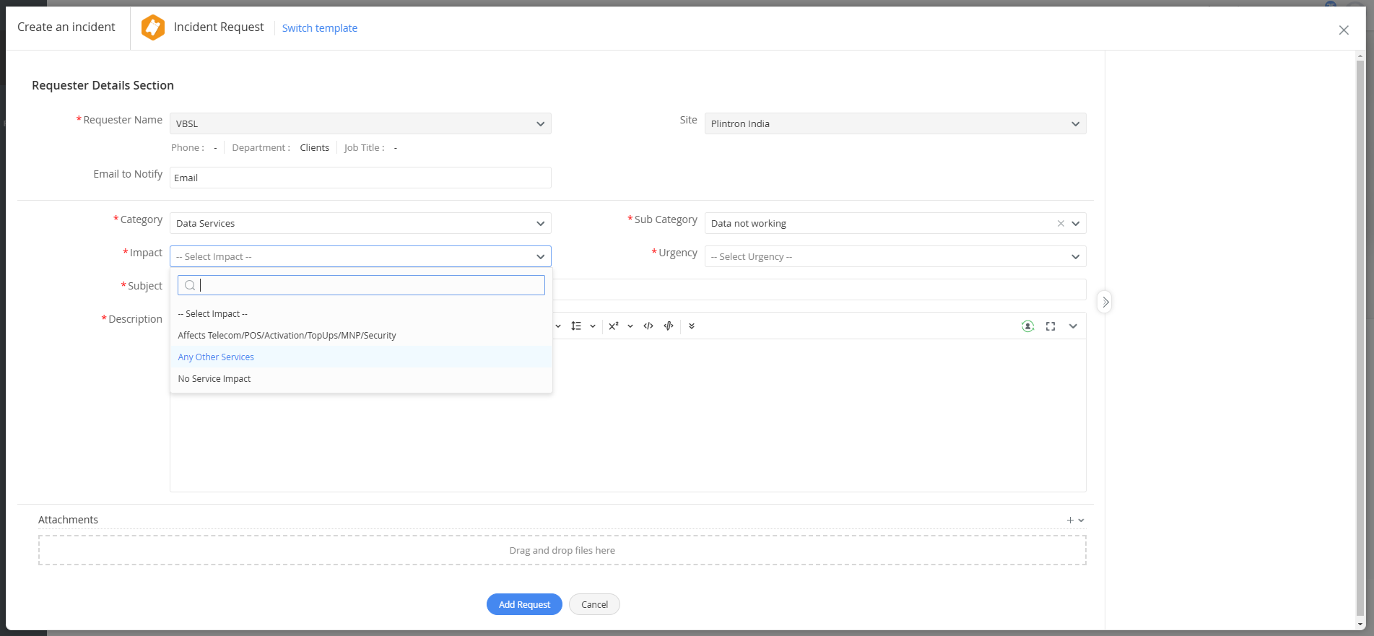
Selecting the Subject- No Impact Service/ Any Other service

Slide 10
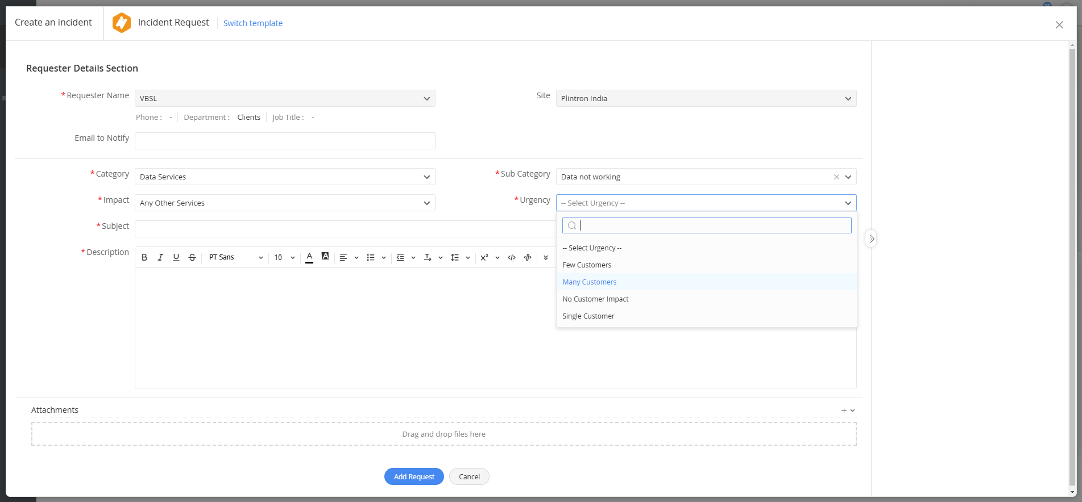
Selecting the Urgency- Single Customer/ Many Customers

Slide 11
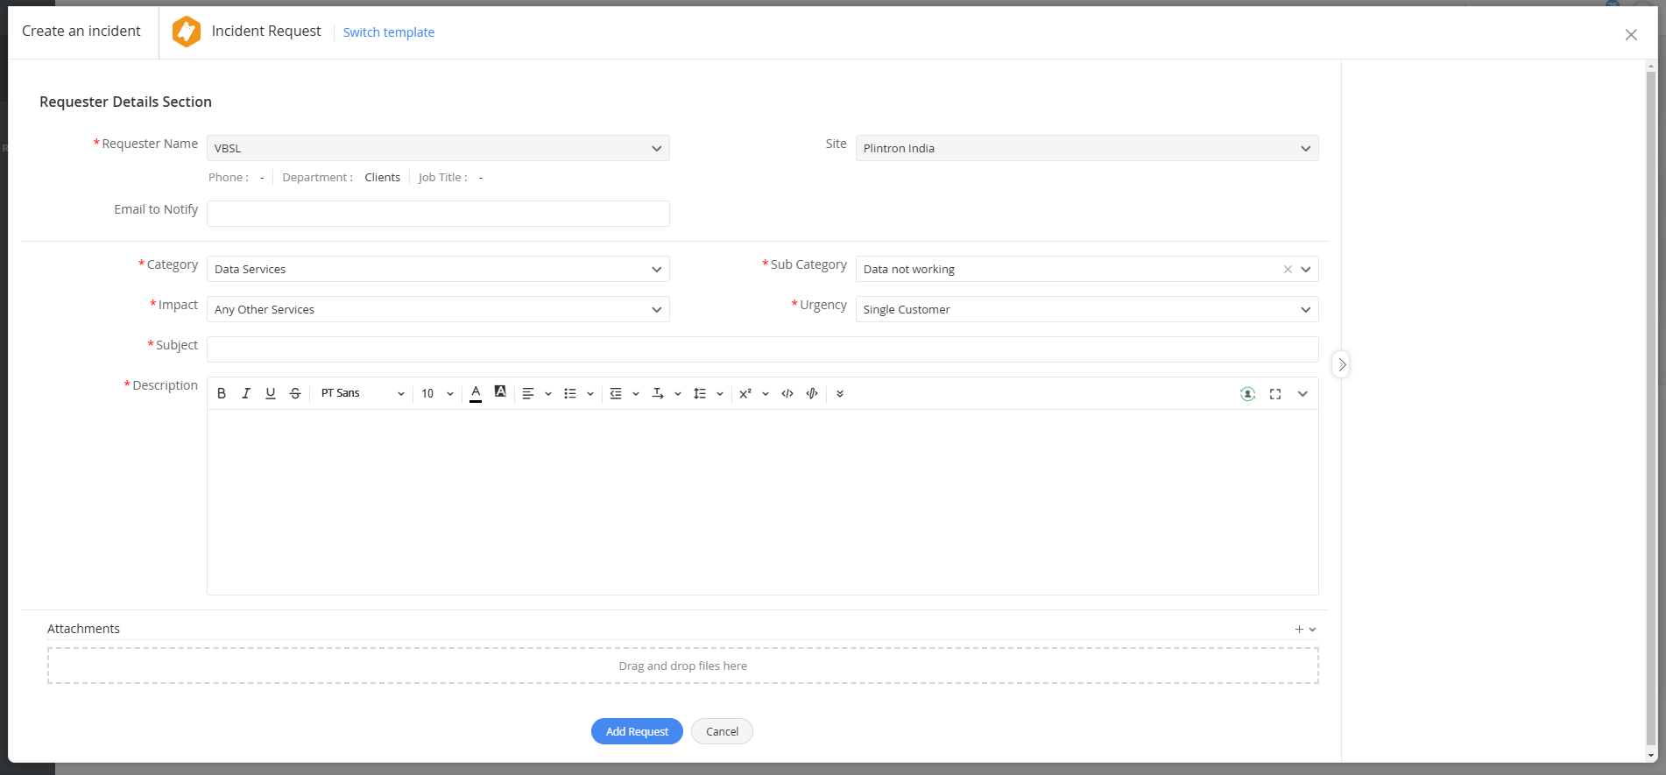
Subject Line- Data not working for BSNL number/ Latching Issue || TT ID(EN_IOT_...)
Mention the exact issue with the BSNL number.
To know the BSNL number you can check the number in SCRM and CMP portals.
In SCRM you can check in e-sim profile and get the BSNL number details.
In the CMP Portal, the second highlighted numbers are BSNL numbers please use this reference while raising the TT

Slide 12
Thank you !

